Slide 1
Radio Receiver
Andrei Vasilev and Joshua Sevick

Slide 2
Receiver goals
Frequency Range 3.5 – 14.5 MHz
Tayloe mixer
Gain of 5
SSB reception, HAM radio use

Slide 3
Schematic*
01
Corrected to account for the wrong pinout

Slide 4
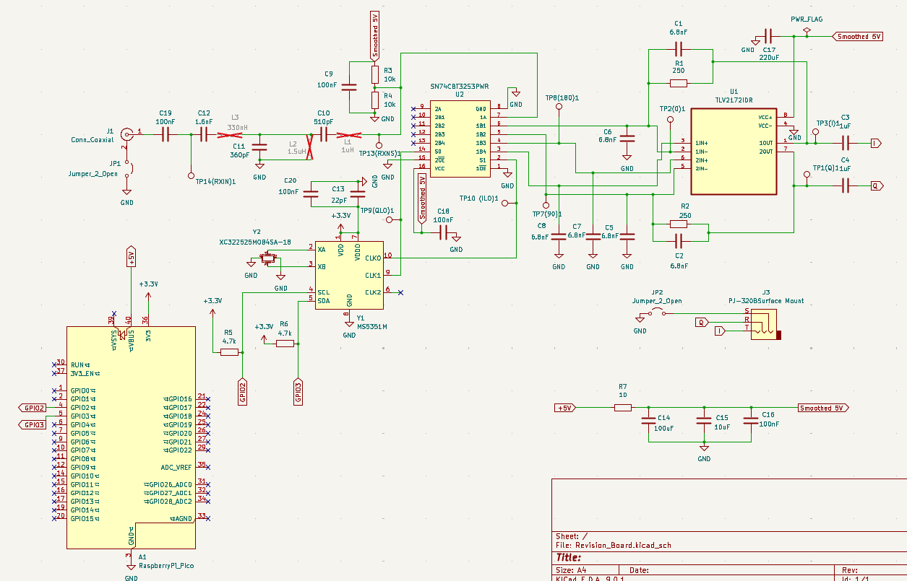

Slide 5
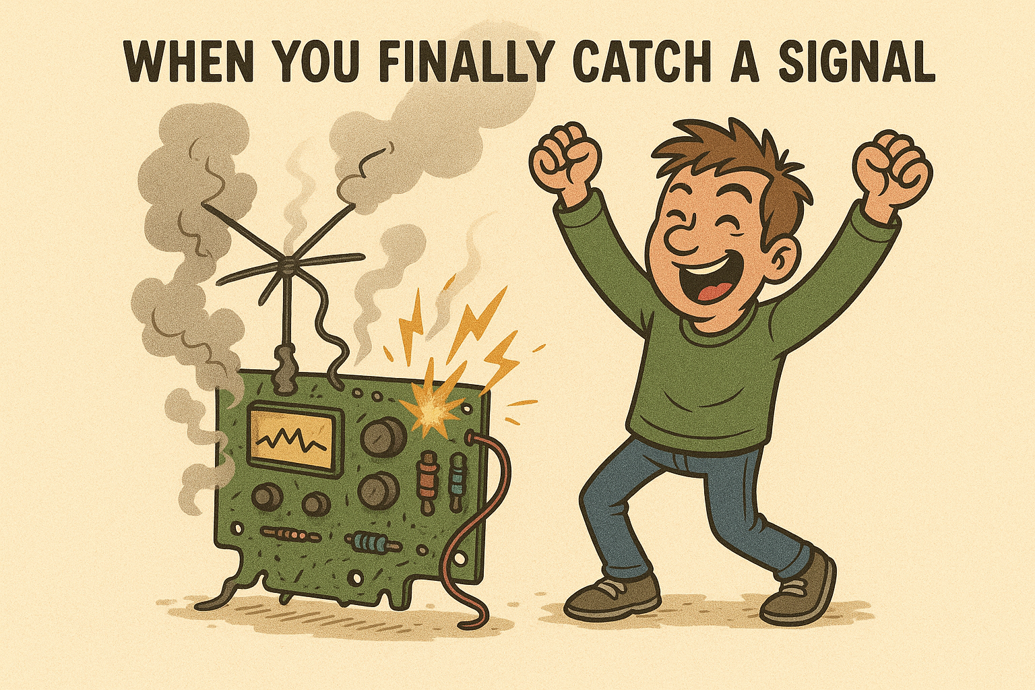
Key features
No transformer
Band pass filter
Hand wound (winded) inductors
Tayloe mixer
Test points for tracking down bugs
Sensitivity down to 1 uV

Slide 6
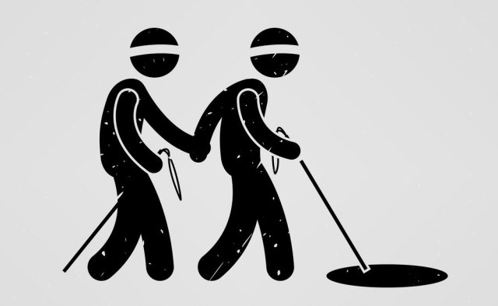
Initial Struggles
Mistaken parts
74HC4052 didn’t meet frequency spec
Op-amp: NE5532 wasn’t rail to rail
ChatGPT led us astray
With the help of Dr. Frohne, SN74CBT3253 and TLV2172IDR were chosen

Slide 7
02
Board Layout*
Reflects how the board actually is

Slide 8
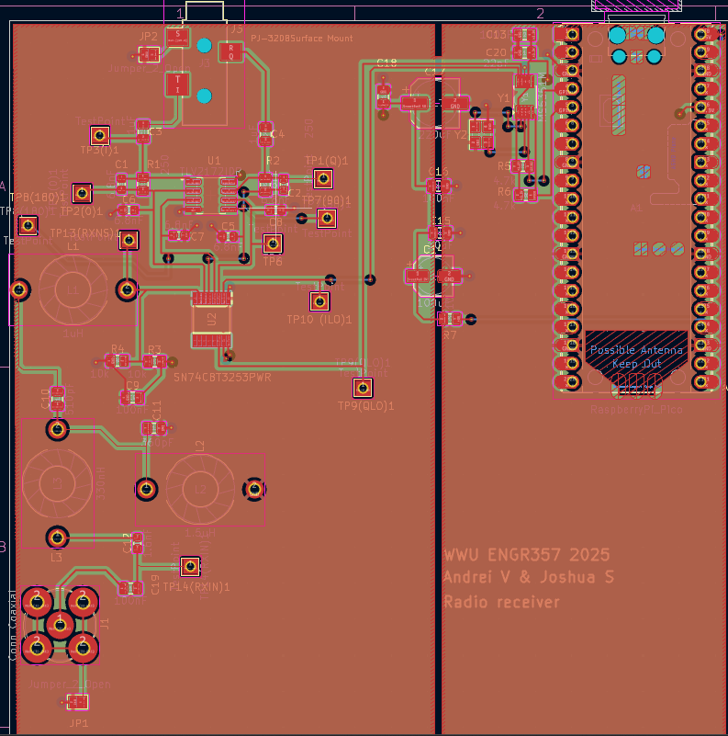

Slide 9
Struggles
Incorrect initial pin assignment
Online footprint for the op amp had the second op amp inputs reversed
Ended up having positive feedback instead of negative
Led to saturated op amp
0, 90, 180, and 270 degree phases were summed wrong
Instead of the difference between 0 and 180 and 90 and 270, it was the difference between 0 and 90 and 90 and 270
Led to bad image rejection

Slide 10
Fixes
Drill baby drill!
Drilled into the traces to sever the connections
Hand soldered connections
Using the test points as pad connections
Image rejection fix
Band pass filter was interfering with the input signal
Bypassed the bandpass filter to get cleaner signal.
Achieved better image rejection at 1 uV

Slide 11
Hardware
03
Signal strength, hardware fixes, and image rejection

Slide 12
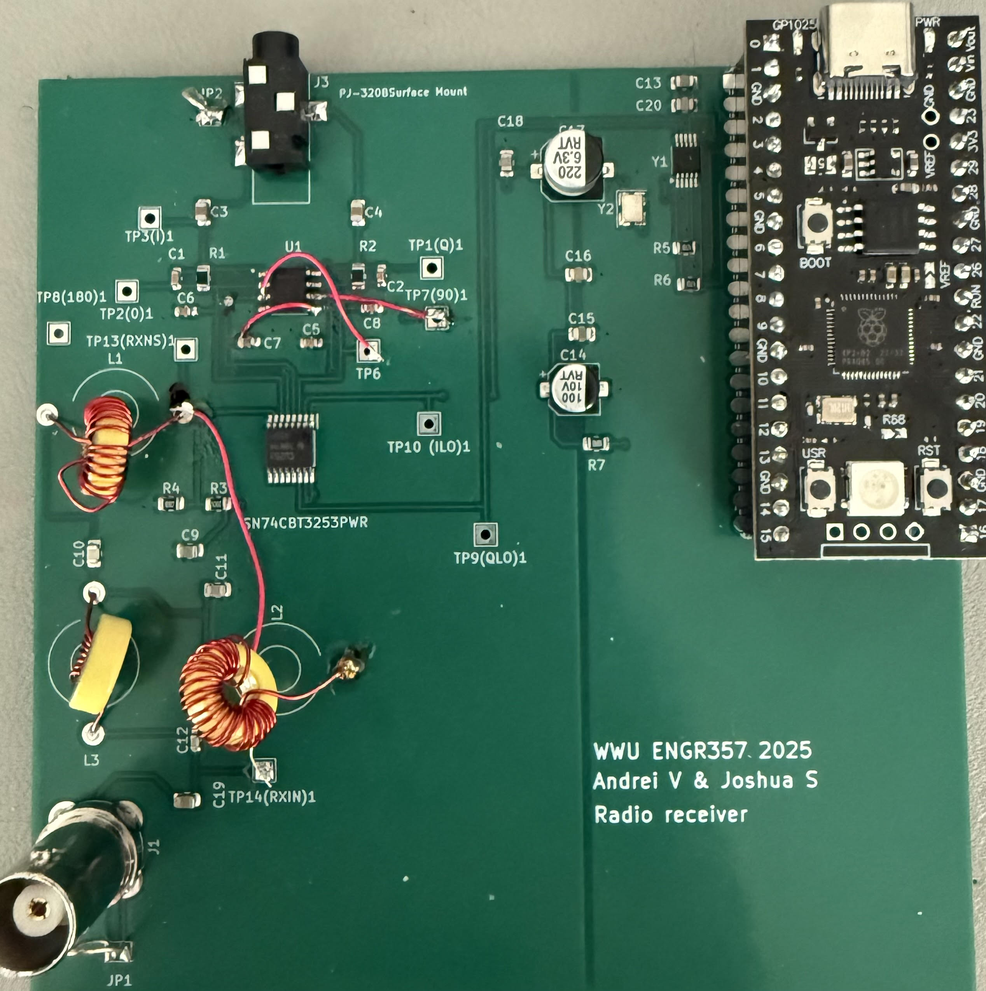

Slide 13
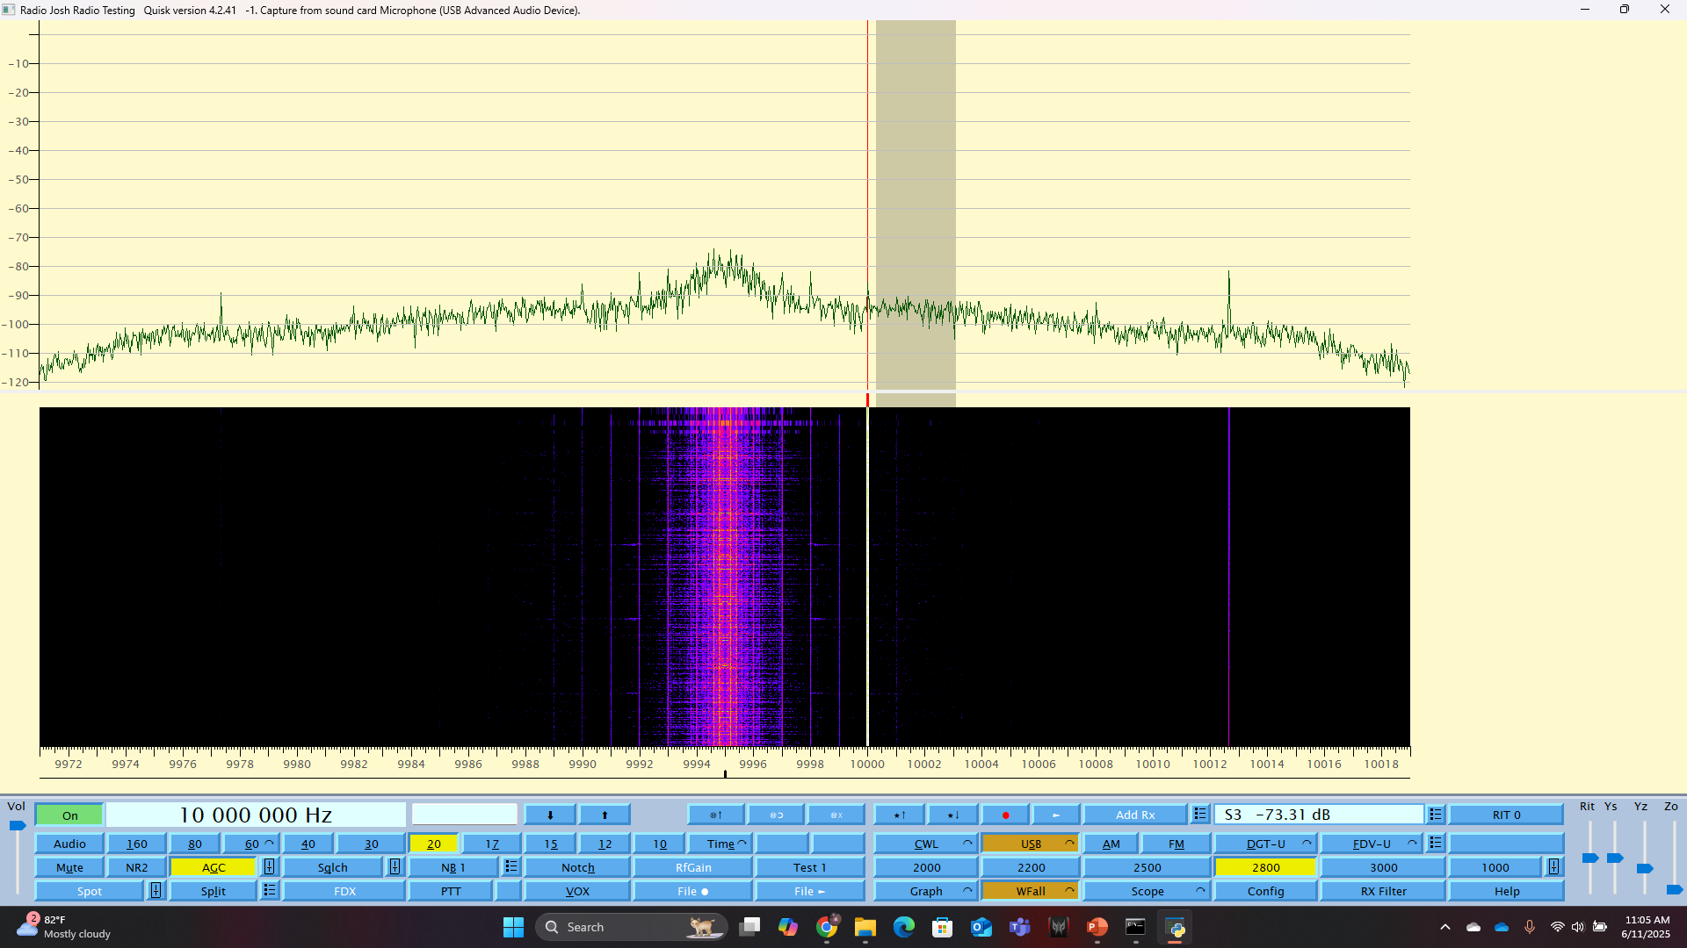
At 1 uV

Slide 14

At 3 uV

Slide 15
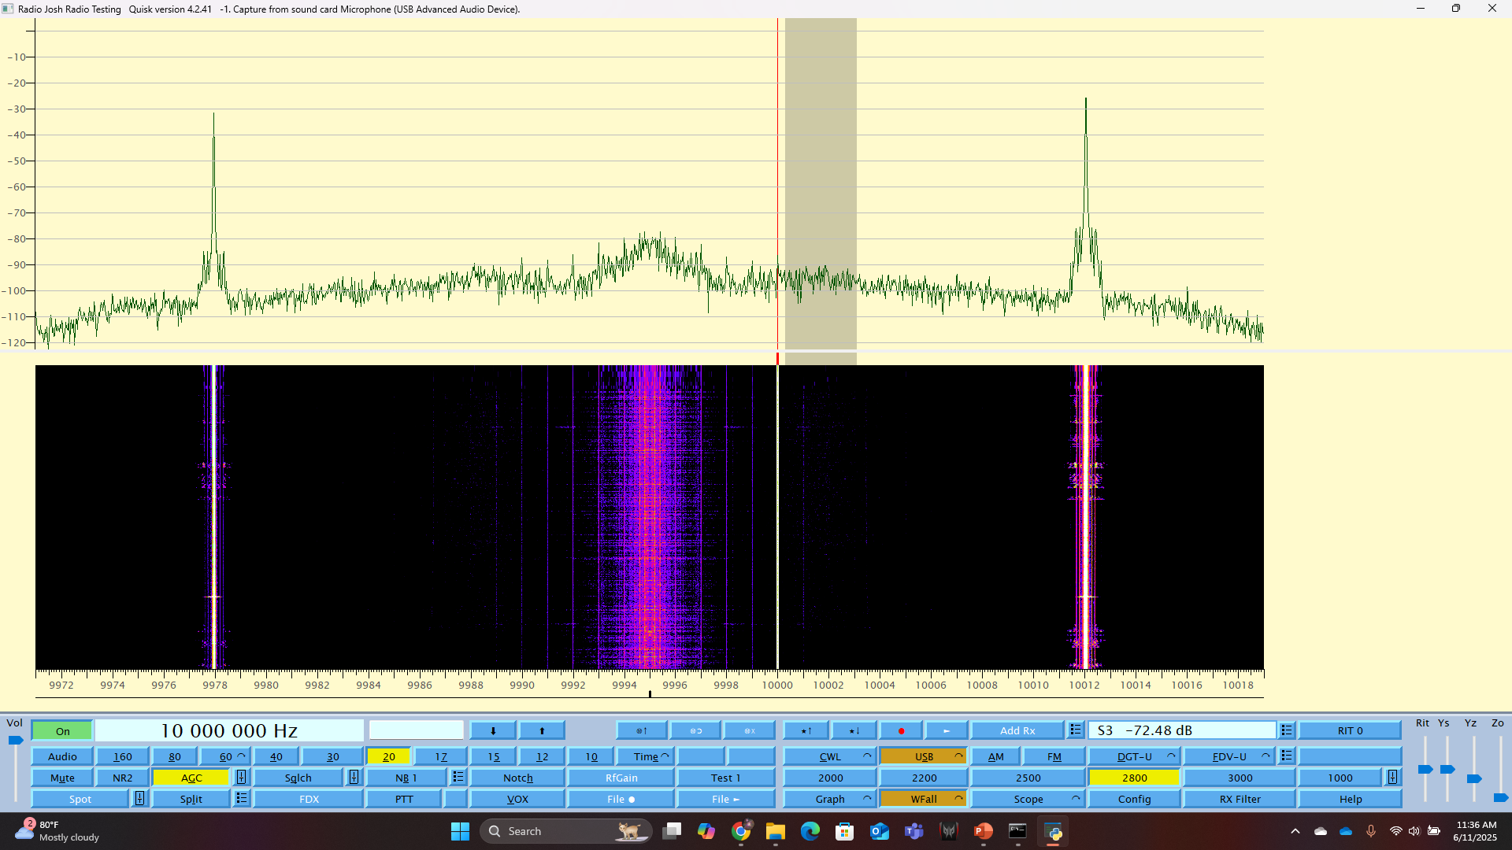
At 1 mV

Slide 16
3-Fold Problem
The 1:4 MUX was wired for a binary clock instead of I2C.
Wired for 0, 1, 2 ,3 instead of 0, 1, 3, 2.
Incorrect phase summing
0/90 degrees phase summation 180/270 phase difference
Incorrect schematic footprint.
The datasheet revealed that we had positive feedback instead of negative.
The positive and negative terminals were reversed

Slide 17
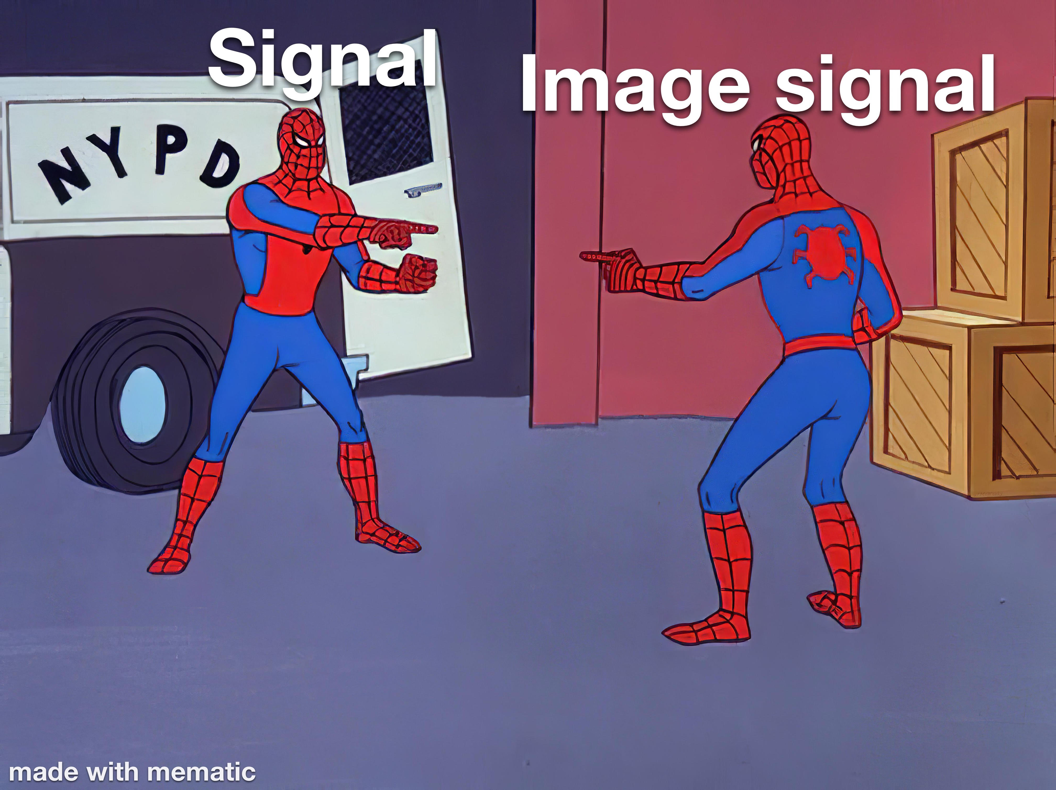
Room for improvement
Image rejection becomes flawed at louder signals
Quisk image rejection could not be figured out and implemented
Hardware was faulty. We should have spent more time reviewing our design before we printed it

